Slide 1
Performance Optimization in SQL
Daniel Peshkov

Slide 2
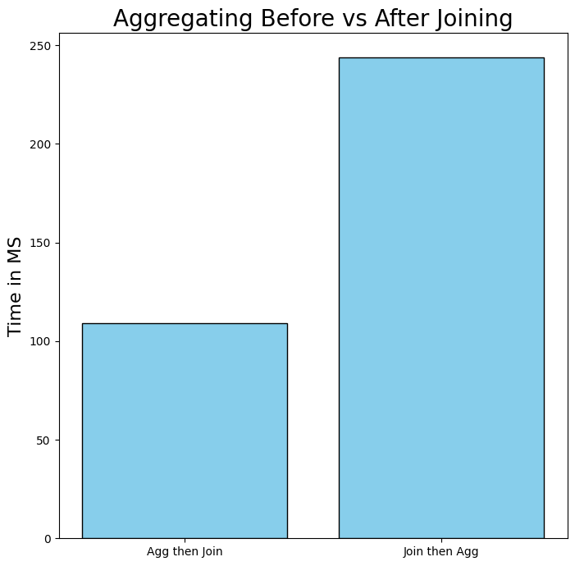
Less Data = Faster Execution
Select specific columns
Reduce Table Size
Save common queries into separate table
Aggregate, Limit and Group

Slide 3
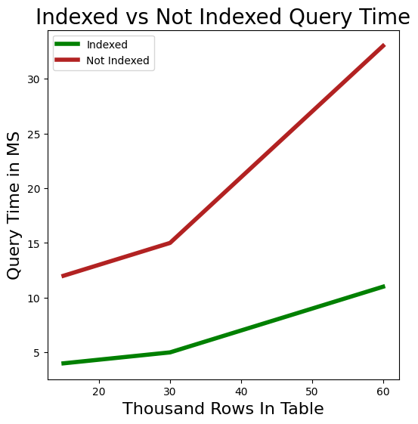
Non-Clustered Index
Seek vs Scan
Difference becomes larger with larger table sizes
Slow Down Insertion Performance
Require Additional Memory

Slide 4
Indexable Queries
Search ARGument Able (Sargable)
Functions on the column
Wildcard Operators (% or _)
SELECT * FROM orders
WHERE MONTH(order_date) = 1
AND YEAR(order_date) = 2014;
VS
SELECT * FROM orders
WHERE order_date >= ‘20140101’
AND order_date < ‘20140201’;

Slide 5
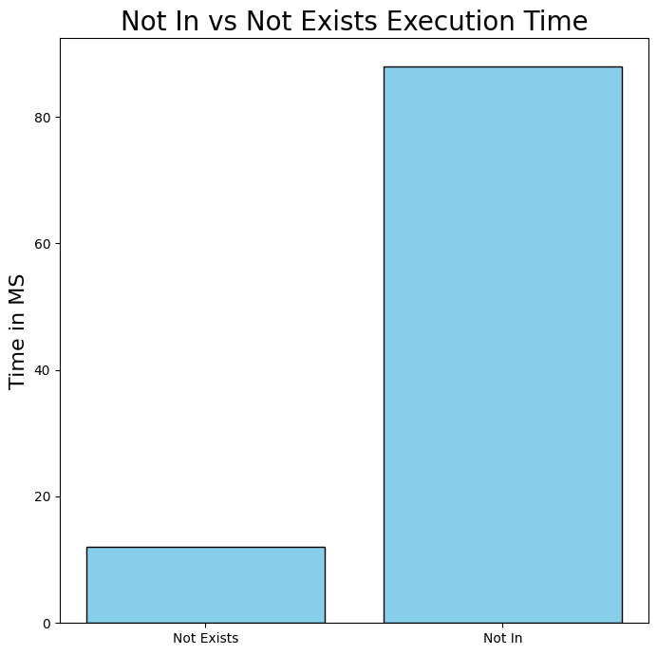
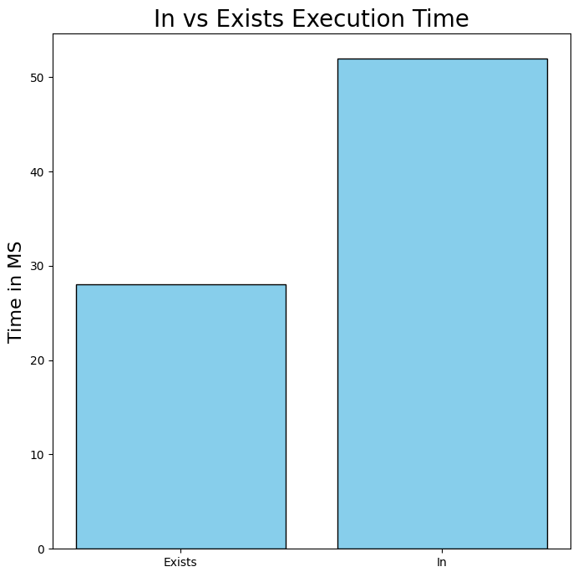
In vs Exist
Null handling
Performance Varies by DB

Slide 6
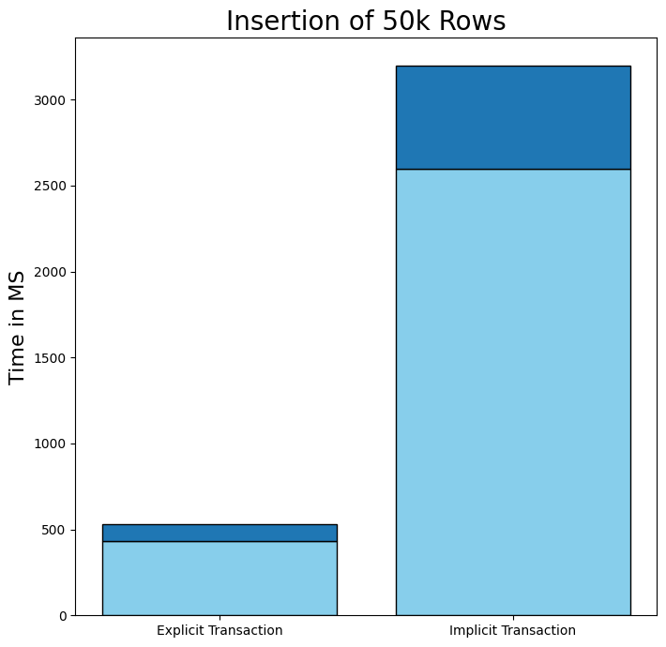
Insertion Performance
Bulk insertion is optimized
Transaction Wrapping Default
Explicit Transaction 6x Faster!

Slide 7
Key Takeaways
Use Less Data
Use Indexes
Make sure your query doesn’t ignore indexes
Compare Exists vs In
Use Transactions Wrap insertions in a transaction- both for ACID integrity and performance
Test on your data

